Slide 1
We are the key ally for healthcare organisations to build data-driven healthcare ecosystem.

Slide 2





Patient-centric approach
[01] Real World Data at Scale
Digitization of health data has been process-centric, making data messy, sparse and inaccessible.
AI
Legacy Healthcare Data Architecture
Patient-centric Data Architecture

Slide 3
0.1
Introduction to the OMOP CDM

Slide 4
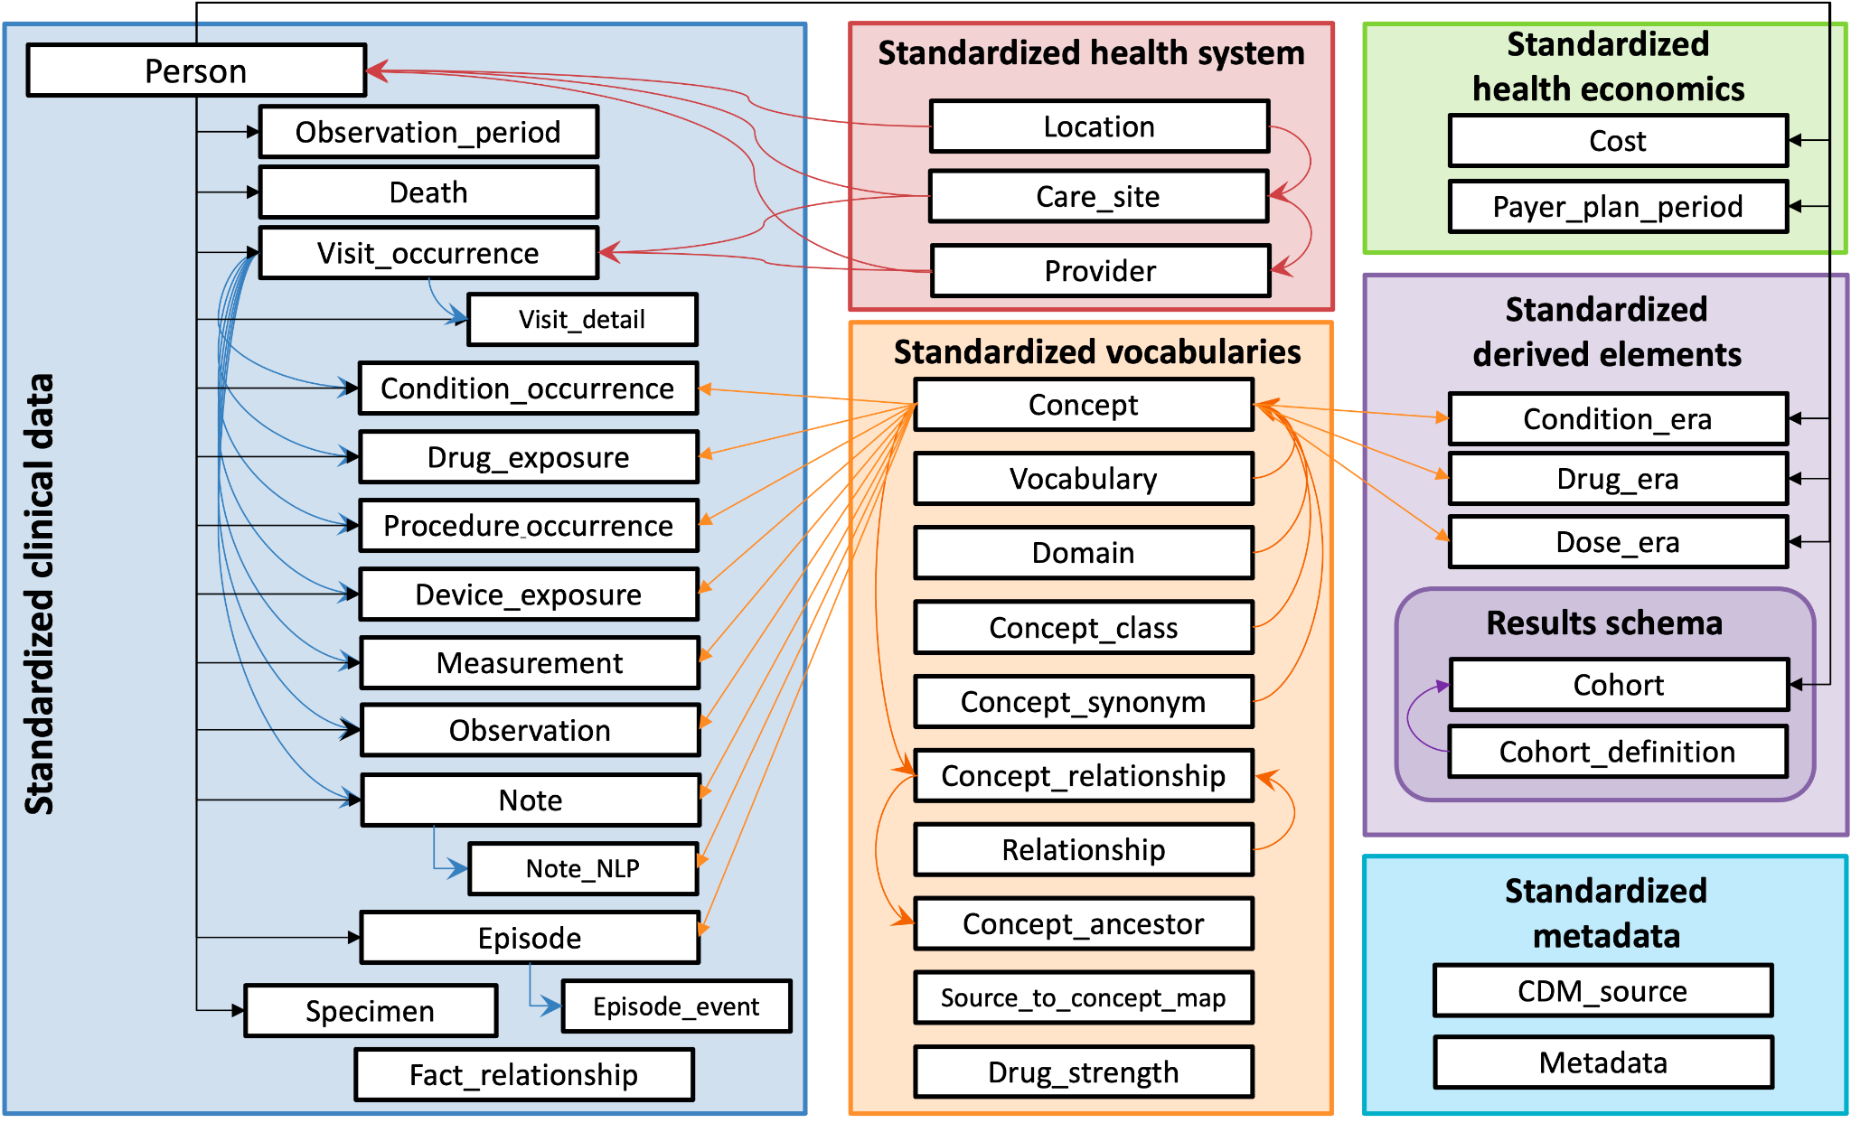
OMOP Common Data Model
Goals
OMOP Common Data Model is designed to standardize the structure and content of observational data and to enable efficient analyses that can produce reliable evidence. Based on existing terminologies and clinical vocabularies.
DIAGNOSIS & PROCEDURES
SNOMED ICD 10-9
ADMINISTRATION ROUTES
SNOMED
SERVICES
SNOMED
DRUGS
RXNORM
RXNORM EXTENSION
UNITS
UCUM
LAB TESTS
LOINC
Content Standardization: Representing all of the clinical entities or attributes using concept_id’s (standard codes) to normalize any existing coding system.
Structure Standardization: Data Model is patient centric and all the events are normalized in a concept_id.
‹#›

Slide 5
OMOP Common Data Model
Goals
OMOP CDM Versions:
3.0 (old)
5.3
5.4
6.0 (working in progress)
Fully specified, freely available -> github
Information about the versions:
https://ohdsi.github.io/CommonDataModel/cdm54.html
‹#›

Slide 6
OMOP Common Data Model
Databases, SQL and R
What is a database (DB)?
Some basic characteristics of databases:
DATABASE STRUCTURAL MODEL
DBMS: SOFTWARE FOR MANAGING THE DATABASE
DEFINITION OF SCHEMAS (TABLES, RELATIONSHIPS, CONSTRAINTS)
SYSTEM DESIGNED TO STORE, MANAGE, AND RETRIEVE DATA EFFICIENTLY.
THE DATABASE STRUCTURE DEPENDS ON THE NATURE AND VOLUME OF THE DATA.
‹#›

Slide 7
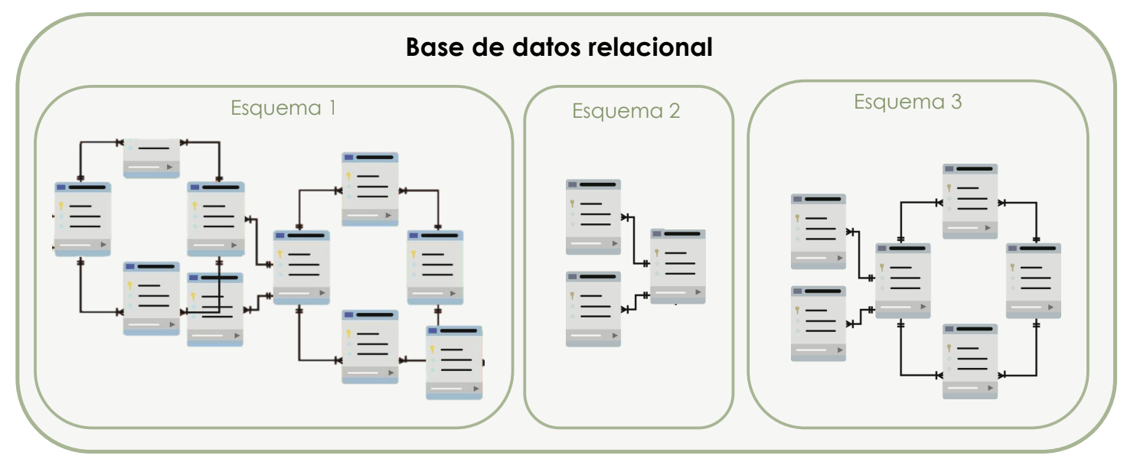
OMOP Common Data Model
Databases, SQL and R
‹#›

Slide 8
OMOP Common Data Model
Databases, SQL and R
PURPOSE IN SCHEMA DEFINITION:
ORGANIZE DATA IN A STRUCTURED WAY
SIMULTANEOUS ACCESS WITHOUT INTERFERING WITH EXTERNAL PROCESSES
DATA INTEGRITY
‹#›

Slide 9
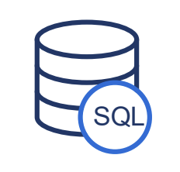
OMOP Common Data Model
Databases, SQL and R
SQL: Standard language for interacting with the database
Types of SQL commands:
DATA DEFINITION (create, alter, drop tables)
DATA MANIPULATION (insert into, update, delete)
DATA QUERY (select)
DATA CONTROL
‹#›

Slide 10
OMOP Common Data Model
Databases, SQL and R
SQL
Standard language used by databases.
SQL is optimized for handling and manipulating large volumes of data.
Problem: It does not have support for performing statistical operations.
R
Programming language widely used in statistics.
R is strong in data manipulation, statistical analysis, and visualization.
Problem: It might not be efficient for large databases.
‹#›

Slide 11
OMOP Common Data Model
Databases, SQL and R
Combine SQL and R to leverage the advantages of each tool.
SQL:
Database creation and management, stored on the server.
R:
Connection to the server to access the database (DB).
Manipulation and analysis of the data (located on the server).
Exporting the results from the server to our computer.
‹#›

Slide 12
OMOP Common Data Model
Goals
Example: Hgb in blood: 9 g/dL
Hemoglobin [Mass/volume] in Blood
3000963
measurement_id | person_id | measurement_concept_id | measurement_date | value_as_number | unit_concept_id | provider_id | visit | …
1 | 243 | 3000963 | 2021-10-12 | 9 | 8713 | 123 | 896
1. Content Standardization:
concept_id
2. Structure Standardization:
Measurement Table
‹#›

Slide 13
OMOP Common Data Model
Goals
Example: Hgb en sangre: 9 g/dL
Hemoglobin [Mass/volume] in Blood
3000963
measurement_id | person_id | measurement_concept_id | measurement_date | value_as_number | unit_concept_id | provider_id | visit | …
1 | 243 | 3000963 | 2021-10-12 | 9 | 8713 | 123 | 896
1. Content Standardization:
concept_id
2. Structure Standardization:
Measurement Table
‹#›

Slide 14
Content Standardization
OMOP Common Data Model
concept_id
concept_name
3000963
Hemoglobin [Mass/volume] in Blood
domain
Hemoglobin
Standard concepts
True
Measurements
concept
Concept class ID
Lab Test
‹#›

Slide 15
2. Structure Standardization
OMOP Common Data Model
Person
Concept
person_id | year_of_birth | gender_concept_id | …
243 | 1974 | 8532
244 | 1944 | 8507
245 | 1991 | 8507
concept_id | concept_name | …
8532 | Female
8507 | Male
3000963 | Hemoglobin …
Measurement
measurement_id | person_id | measurement_concept_id | measurement_date | value_as_number | …
1 | 243 | 3000963 | 2021-10-12 | 9
2 | 243 | 3000963 | 2021-10-14 | 9.5
3 | 243 | 3000963 | 2021-10-15 | 10.2
‹#›

Slide 16
2. Structure Standardization
OMOP Common Data Model
Person
Concept
person_id | year_of_birth | gender_concept_id | …
243 | 1974 | 8532
244 | 1944 | 8507
245 | 1991 | 8507
concept_id | concept_name | …
8532 | Female
8507 | Male
3000963 | Hemoglobin …
Measurement
measurement_id | person_id | measurement_concept_id | measurement_date | value_as_number | …
1 | 243 | 3000963 | 2021-10-12 | 9
2 | 243 | 3000963 | 2021-10-14 | 9.5
3 | 243 | 3000963 | 2021-10-15 | 10.2
‹#›

Slide 17
2. Structure Standardization
OMOP Common Data Model
‹#›

Slide 18
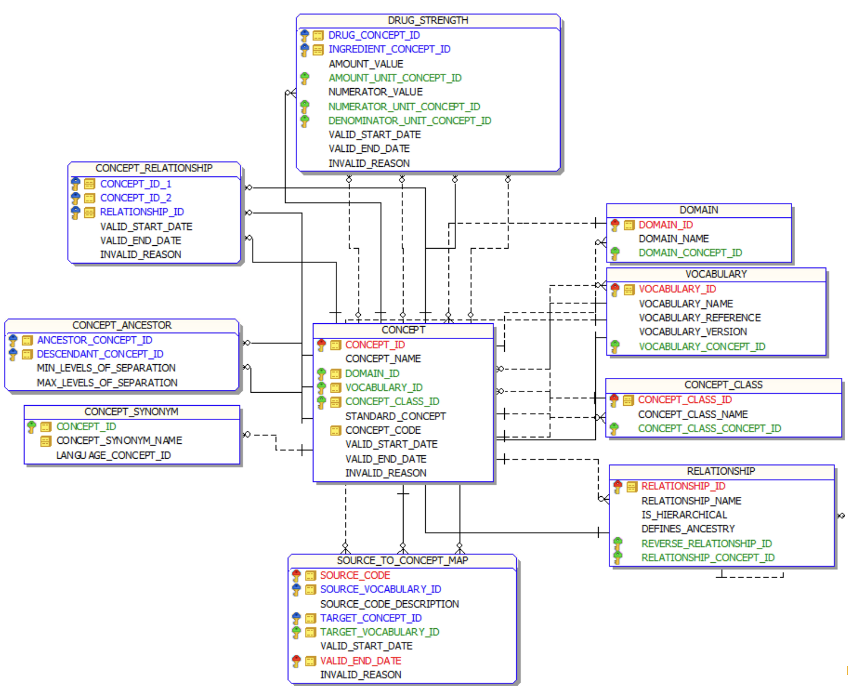
2. Structure Standardization
OMOP Common Data Model
‹#›

Slide 19
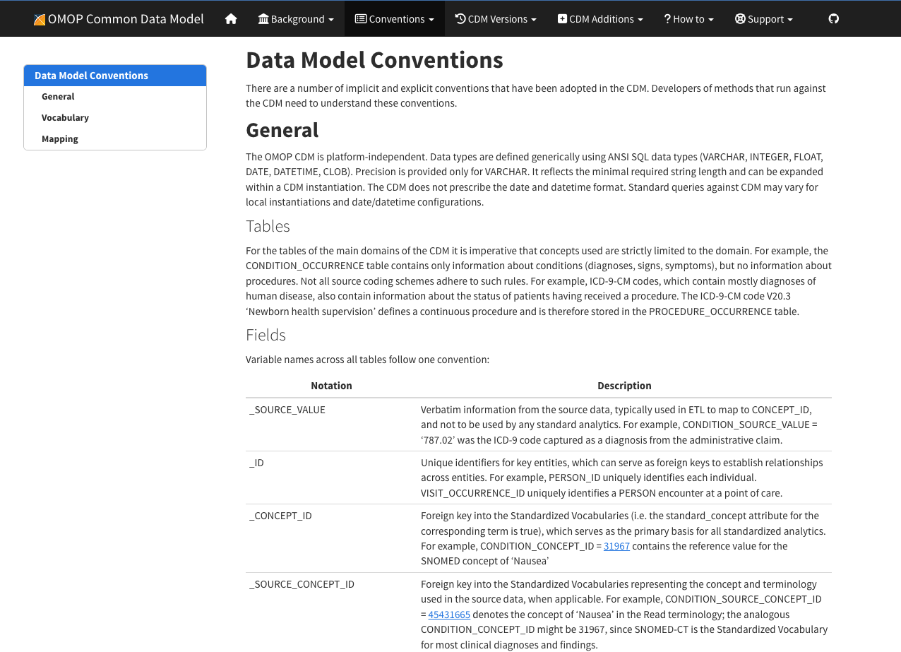
2. Structure Standardization
OMOP Common Data Model
Required tables:
person
observation_period
Fields:
_id
_concept_id
_source_concept_id
_source_value
_type_concept_id
Target concept domain determines target table
‹#›

Slide 20
[05]
Data Quality Dashboard

